Slide 1
VITAMINS
Vitamins are organic components in food that are needed in very small amounts for growth and maintaining good heath.

Slide 2
VITAMINS
CLASSIFICATION
FAT SOLUBLE :Vit A, Vit D, Vit E, Vit K
2) WATER SOLUBLE:
Vit C, Thiamine(B1) ,Riboflavin(B2), Niacin (B3), Pyridoxine(B6), Biotin,Pantothenic acid (B5), Folic acid (B9)
Vit B12(Cyanocobalamin)

Slide 3
CHARACTERISTICS
Vitamins are required in small quantities in the diet because they cannot be synthesized by the body.
Water soluble vitamins cannot be stored in human tissues.Their excess is excreted with urine.
Significant amounts of fat soluble vitamins can be stored in adipose tissue and the liver.

Slide 4
FUNCTIONS
1) They build resitance of the body against
2) Prevent and cure many diseases caused by deficiency
3) Helps the digestion andutilization of mineral salts and carbohydrates in the
4) Stimulate and give strenght to digestive and nervous

Slide 5
VITAMIN A
Vitamin A is group of unsaturated nutritional organic compounds, that includes retinol,retinal,retinoic acid and several provitamin A, among which provitamin A carotenoids, among which beta-carotene is most important
DAILY REQUIREMENT
Men and Women – 600 mcg
Pregenancy and lactation- 950 mcg
Infants-350 mcg
Children- 600 mcg

Slide 6
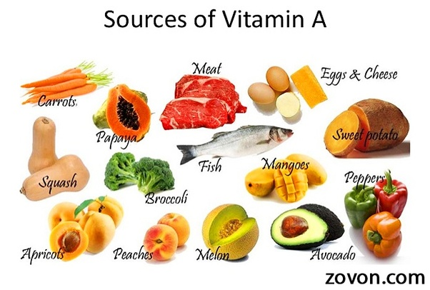
ENDOPLASMIC RETICULUM

Slide 7
FUNCTIONS
1)Vision (RHODOPSIN- memrane protein in the photoreceptor of retina)
2)Gene transcription
3)Immune Function
4)Embryonic development and reproduction
5) Bone metabolism
6) Hematopoiesis (the production of blood cells and platrelets)
7)Skin and cellular health
8) Antioxidant activity

Slide 8
VITAMIN D
Vitamin D refers to a group of fat-soluble secosteroids ( a type of steroid with a broken ring) found in liver and fish oils or obtained by irradiating provitamin D with ultraviolet light and are responsible for enhancing intestinal absorption of calcium,iron, magnessium, phosphate and zinc.It is also called SUNSHINE VITAMIN. It is avialable in two forms a) CHOLECALCIFEROL (Vit D3): made up from 7-dehydrocholestrol in the skin of animals and humans. b) CACIFEROL (Vit D2): is obtained by irradiation of ergo-sterol

Slide 9
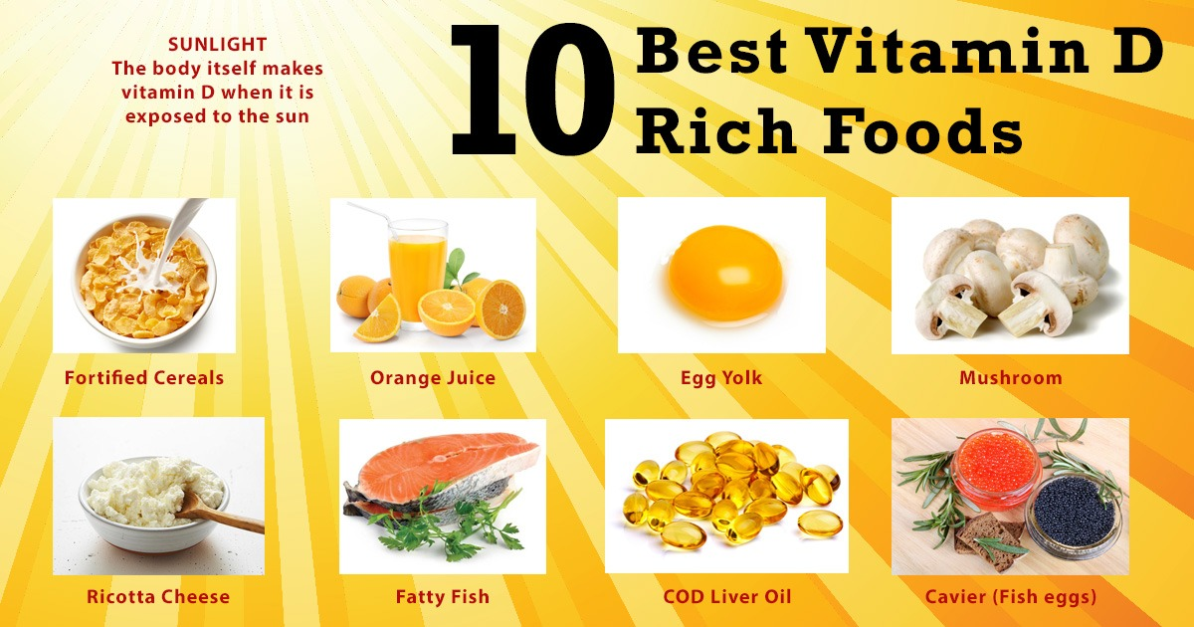
DAILY REQUIREMENT
Men and Women- 0.01 mg
Pregenancy and lactation-0.01 mg
Infants and Children- 0.01 mg

Slide 10
FUNCTIONS
1) Calcium Balance
2)Cell Differentiation
3)Immunity
4)Blood Pressure and Regulation
5)Development of Bones and Teeth

Slide 11
VITAMIN E
Vitamin E refers to a group of componds that include both TOCOPHEROLS and TOCOTRIENOLS.They are natural ocurring anti-oxidant.It is also called anti ageing factor

Slide 12
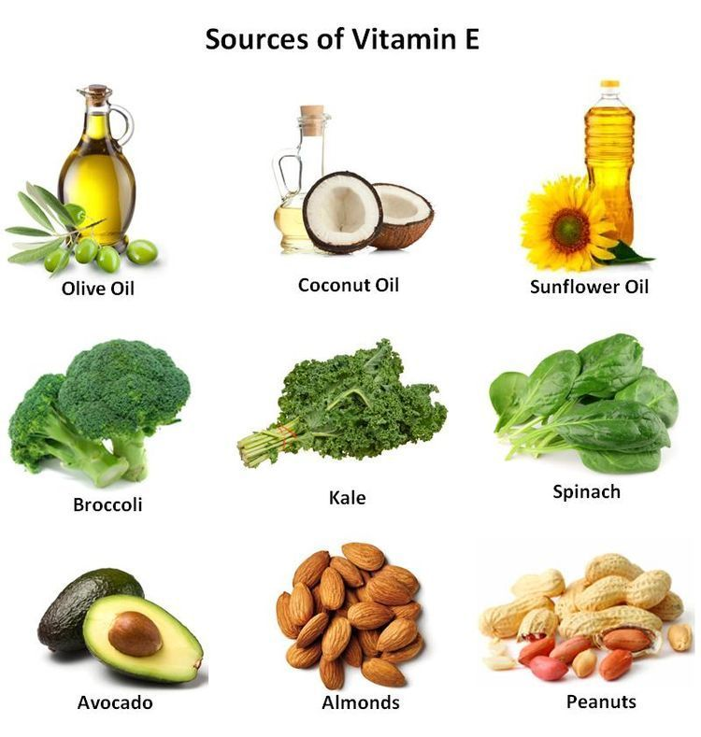
DIETRY SOURCES OF VIATAMIN E
Daily Recommendation Dose
Men – 8-10 mg
Women- 5-8 mg
Children- 8.3 mg
Infants- 4-5 mg

Slide 13
FUNCTIONS OF VITAMIN E
Antioxidant ( most powerful natural)
Free radical scavenger
Protects cell membranes
Protectd LDL from oxidation
Protects double bonds in polyunsaturated fatty acids
Prevents ranacidity
Vitamin E also Plays a role in neurological functions and inhibition of platelet aggregation.

Slide 14
VITAMIN K
Vitamin K refers to group of structurally similar , fat soluble vitamins the human body needs for complete synthesis of certain proteins that are required for blood coagulation and also certain proteins that the body uses to manipulate binding of calcium in bone and other tissues.
Vitamin K is naturally produced by bacteria in the intestines.
It is essential for production of a type of protein called PROTHROMBIN & other factor involve in blood clotting mechanism. Hence it is known as ANTI HEMOAAGRRHIC vitamin.

Slide 15
DAILY REQUIREMENT OF VITAMIN K
Men and Women – 70 to 140 mcg
Chirdren – 35 to 75 mcg

Slide 16
FUNCTIONS OF VITAMIN K
It is essential for the hepatic synthesis of coagulation factor II, V,VII,IX, X
CLOTTING- it prevents HEMORRHAGE only in cases when tere is defective production of prothrombin
OXIDATIVE PHOSPHORYLATION-it acts as a co –factor in oxidative phosphorylation associated with lipid
Vitamin K is needed for carboxylation of glutamyl residue of Ca ++ binding transport beteween the flavincoenzyme and cytochrome system

Slide 17
WATER SOLUBLE VITAMINS
B1-Thiamine
B2-Riboflavin,
B3-Niacin
B5-Pantothenic acid
B6-Pyridoxine
B7-Biotin
B9-Folic acid
B12-Cobalamin
Vitamin C- Ascorbic acid
They are found in yeast,grain,rice,vegetables,fish and meat.
These are essentials coenzymes required in energy relaesing mechanisms (carbohydrate,proteins and fats metabolism)

Slide 18
VITAMIN B1 (THIAMINE)
It is also called Anti Beri Beri factor or Anti Neuritic factor
All living organism use thiaminr,but it is symthesized only in bacteria , fungi and plants
Destroyed by alkali and heat.

Slide 19
DIETRY SOURCES OF VIATAMIN E
Tuna
Sunflower seeds
White beans
Blak beans
Peas
Cranberry
Lentil
Seasame seeds
Daily Requirements
Men- 1.3 mg
Women- 1 mg
Pregnancy and lactation- 2 mg

Slide 20
FUNCTIONS
It is very essential for converting carbohydrate into energy
Treatment of BERI BERI, a condition caused by deficiency of thiamine in the diet. Symptoms incude swelling , tingling or burning sensation in the hands and feet, confusion, difficulty breathing.
Helps in maintaining nervous system.
Necessary for healthy mucous membranes
Helps in digestion of food and strenght to muscles.

Slide 21


